Slide 1

Slide 10- <number>

Slide 2
Chapter 10
Functional Dependencies and Normalization for Relational Databases
Copyright © 2007 Ramez Elmasri and Shamkant B. Navathe

Slide 3
Chapter Outline
1 Informal Design Guidelines for Relational Databases
  1.1Semantics of the Relation Attributes
  1.2 Redundant Information in Tuples and Update Anomalies
  1.3 Null Values in Tuples
  1.4 Spurious Tuples
2 Functional Dependencies (FDs)
  2.1 Definition of FD
  2.2 Inference Rules for FDs
  2.3 Equivalence of Sets of FDs
  2.4 Minimal Sets of FDs
Slide 10- <number>

Slide 4
Chapter Outline
3 Normal Forms Based on Primary Keys
  3.1 Normalization of Relations
  3.2 Practical Use of Normal Forms
  3.3 Definitions of Keys and Attributes Participating in Keys
  3.4 First Normal Form
  3.5 Second Normal Form
  3.6 Third Normal Form
4 General Normal Form Definitions (For Multiple Keys)
5 BCNF (Boyce-Codd Normal Form)
Slide 10- <number>

Slide 5
1 Informal Design Guidelines for Relational Databases (1)
What is relational database design?
  The grouping of attributes to form "good" relation schemas
Two levels of relation schemas
  The logical "user view" level
  The storage "base relation" level
Design is concerned mainly with base relations
What are the criteria for "good" base relations?
Slide 10- <number>

Slide 6
Informal Design Guidelines for Relational Databases (2)
We first discuss informal guidelines for good relational design
Then we discuss formal concepts of functional dependencies and normal forms
  - 1NF (First Normal Form)
  - 2NF (Second Normal Form)
  - 3NF (Third Normal Form)
  - BCNF (Boyce-Codd Normal Form)
Additional types of dependencies, further normal forms, relational design algorithms by synthesis are discussed in Chapter 11
Slide 10- <number>

Slide 7
1.1 Semantics of the Relation Attributes
GUIDELINE 1: Informally, each tuple in a relation should represent one entity or relationship instance. (Applies to individual relations and their attributes).
  Attributes of different entities (EMPLOYEEs, DEPARTMENTs, PROJECTs) should not be mixed in the same relation
  Only foreign keys should be used to refer to other entities
  Entity and relationship attributes should be kept apart as much as possible.
Bottom Line: Design a schema that can be explained easily relation by relation. The semantics of attributes should be easy to interpret.
Slide 10- <number>

Slide 8
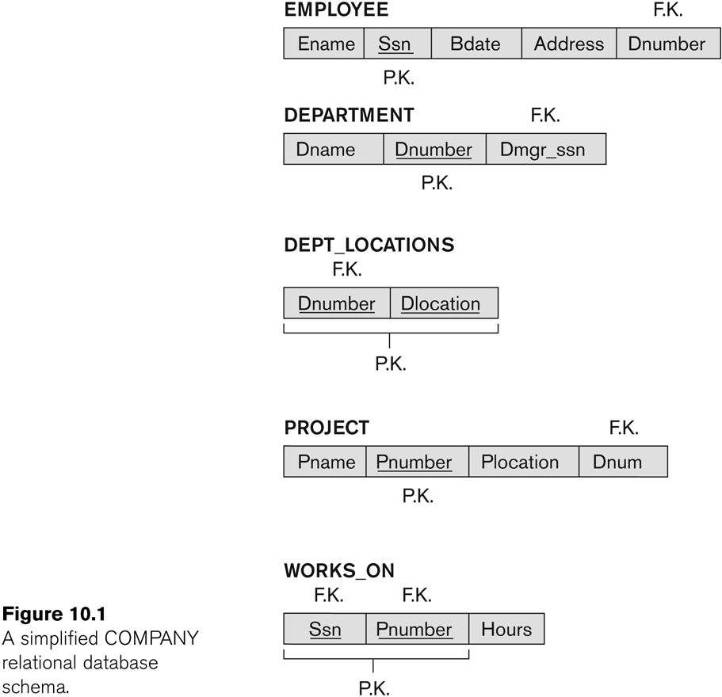
Figure 10.1 A simplified COMPANY relational database schema
Slide 10- <number>

Slide 9
1.2 Redundant Information in Tuples and Update Anomalies
Information is stored redundantly
  Wastes storage
  Causes problems with update anomalies
    Insertion anomalies
    Deletion anomalies
    Modification anomalies
Slide 10- <number>

Slide 10
EXAMPLE OF AN UPDATE ANOMALY
Consider the relation:
  EMP_PROJ(Emp#, Proj#, Ename, Pname, No_hours)
Update Anomaly:
  Changing the name of project number P1 from “Billing” to “Customer-Accounting” may cause this update to be made for all 100 employees working on project P1.
Slide 10- <number>

Slide 11
EXAMPLE OF AN INSERT ANOMALY
Consider the relation:
  EMP_PROJ(Emp#, Proj#, Ename, Pname, No_hours)
Insert Anomaly:
  Cannot insert a project unless an employee is assigned to it.
Conversely
  Cannot insert an employee unless an he/she is assigned to a project.
Slide 10- <number>

Slide 12
EXAMPLE OF AN DELETE ANOMALY
Consider the relation:
  EMP_PROJ(Emp#, Proj#, Ename, Pname, No_hours)
Delete Anomaly:
  When a project is deleted, it will result in deleting all the employees who work on that project.
  Alternately, if an employee is the sole employee on a project, deleting that employee would result in deleting the corresponding project.
Slide 10- <number>

Slide 13
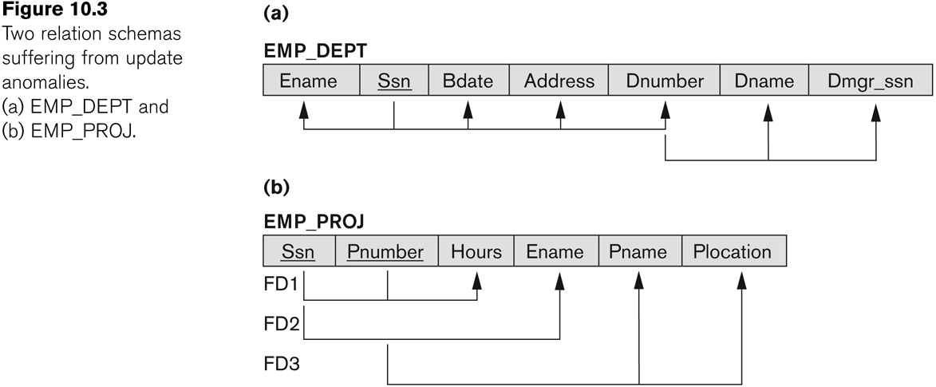
Figure 10.3 Two relation schemas suffering from update anomalies
Slide 10- <number>

Slide 14
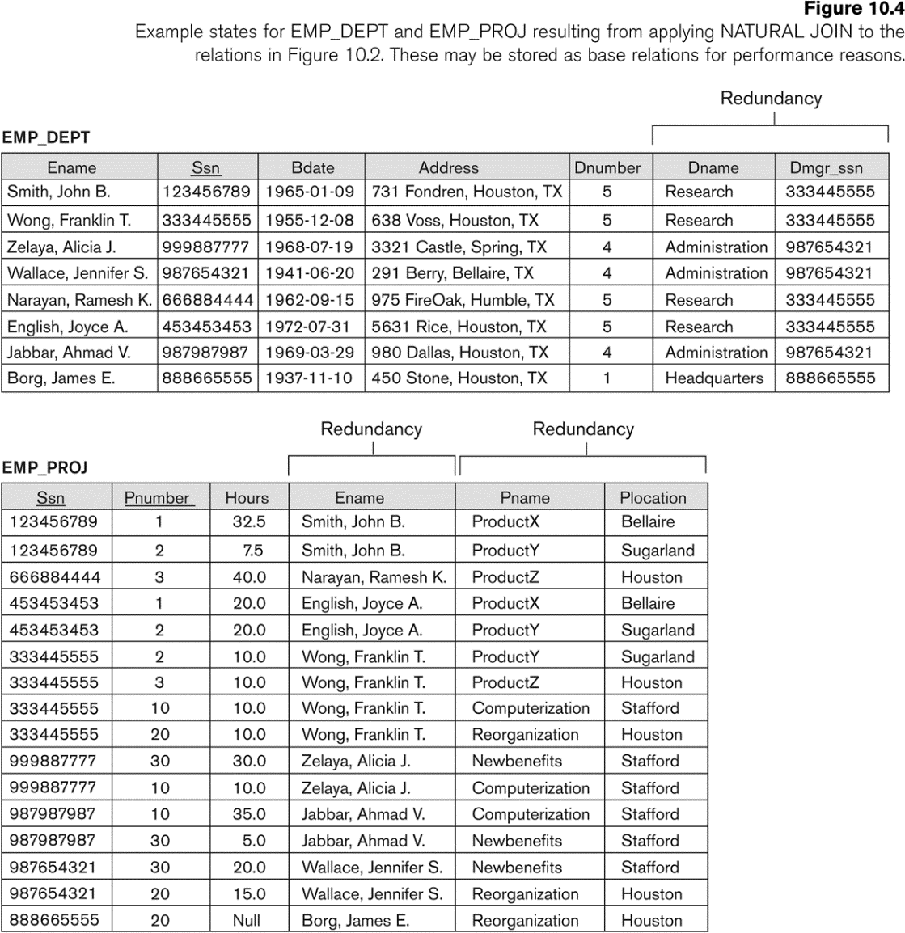
Figure 10.4 Example States for EMP_DEPT and EMP_PROJ
Slide 10- <number>

Slide 15
Guideline to Redundant Information in Tuples and Update Anomalies
GUIDELINE 2:
  Design a schema that does not suffer from the insertion, deletion and update anomalies.
  If there are any anomalies present, then note them so that applications can be made to take them into account.
Slide 10- <number>

Slide 16

1.3 Null Values in Tuples
GUIDELINE 3:
  Relations should be designed such that their tuples will have as few NULL values as possible
  Attributes that are NULL frequently could be placed in separate relations (with the primary key)
Reasons for nulls:
  Attribute not applicable or invalid
  Attribute value unknown (may exist)
  Value known to exist, but unavailable
Slide 10- <number>

Slide 17
1.4 Spurious Tuples
Bad designs for a relational database may result in erroneous results for certain JOIN operations
The "lossless join" property is used to guarantee meaningful results for join operations
GUIDELINE 4:
  The relations should be designed to satisfy the lossless join condition.
  No spurious tuples should be generated by doing a natural-join of any relations.
Slide 10- <number>

Slide 18
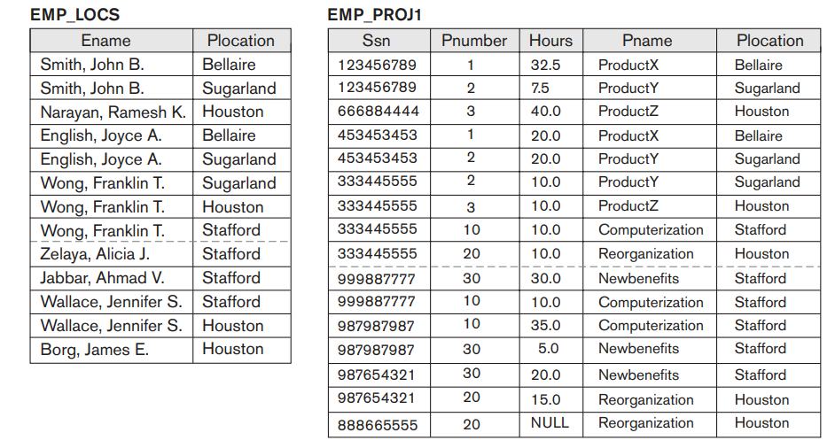
Slide 10- <number>

Slide 19
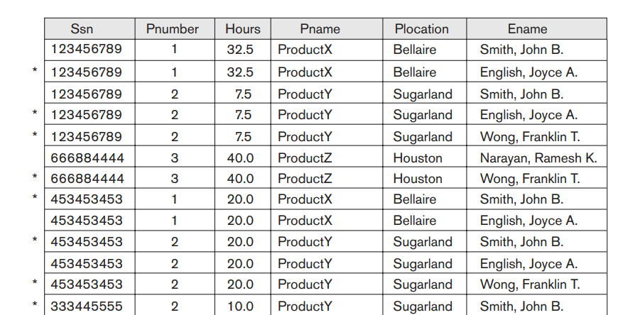
Spurious Tuples
Slide 10- <number>

Slide 20
Spurious Tuples (2)
There are two important properties of decompositions:
  Non-additive or losslessness of the corresponding join
  Preservation of the functional dependencies.
Note that:
  Property (a) is extremely important and cannot be sacrificed.
  Property (b) is less stringent and may be sacrificed. (See Chapter 11).
Slide 10- <number>

Slide 21
2.1 Functional Dependencies (1)
Functional dependencies (FDs)
  Are used to specify formal measures of the "goodness" of relational designs
  And keys are used to define normal forms for relations
  Are constraints that are derived from the meaning and interrelationships of the data attributes
A set of attributes X functionally determines a set of attributes Y if the value of X determines a unique value for Y
Slide 10- <number>

Slide 22
Functional Dependencies (2)
X -> Y holds if whenever two tuples have the same value for X, they must have the same value for Y
  For any two tuples t1 and t2 in any relation instance r(R): If t1[X]=t2[X], then t1[Y]=t2[Y]
X -> Y in R specifies a constraint on all relation instances r(R)
Written as X -> Y; can be displayed graphically on a relation schema as in Figures. ( denoted by the arrow: ).
FDs are derived from the real-world constraints on the attributes
Slide 10- <number>

Slide 23
Examples of FD constraints (1)
Social security number determines employee name
  SSN -> ENAME
Project number determines project name and location
  PNUMBER -> {PNAME, PLOCATION}
Employee ssn and project number determines the hours per week that the employee works on the project
  {SSN, PNUMBER} -> HOURS
Slide 10- <number>

Slide 24
Examples of FD constraints (2)
An FD is a property of the attributes in the schema R
The constraint must hold on every relation instance r(R)
If K is a key of R, then K functionally determines all attributes in R
  (since we never have two distinct tuples with t1[K]=t2[K])
Slide 10- <number>

Slide 25
2.2 Inference Rules for FDs (1)
Given a set of FDs F, we can infer additional FDs that hold whenever the FDs in F hold
Armstrong's inference rules:
  IR1. (Reflexive) If Y subset-of X, then X -> Y
  IR2. (Augmentation) If X -> Y, then XZ -> YZ
    (Notation: XZ stands for X U Z)
  IR3. (Transitive) If X -> Y and Y -> Z, then X -> Z
IR1, IR2, IR3 form a sound and complete set of inference rules
  These are rules hold and all other rules that hold can be deduced from these
Slide 10- <number>

Slide 26
Inference Rules for FDs (2)
Some additional inference rules that are useful:
  Decomposition: If X -> YZ, then X -> Y and X -> Z
  Union: If X -> Y and X -> Z, then X -> YZ
  Psuedotransitivity: If X -> Y and WY -> Z, then WX -> Z
The last three inference rules, as well as any other inference rules, can be deduced from IR1, IR2, and IR3 (completeness property)
Slide 10- <number>

Slide 27
Inference Rules for FDs (3)
Closure of a set F of FDs is the set F⁺ of all FDs that can be inferred from F
Closure of a set of attributes X with respect to F is the set X⁺ of all attributes that are functionally determined by X
X⁺ can be calculated by repeatedly applying IR1, IR2, IR3 using the FDs in F
Slide 10- <number>

Slide 28
2.3 Equivalence of Sets of FDs
Two sets of FDs F and G are equivalent if:
  Every FD in F can be inferred from G, and
  Every FD in G can be inferred from F
  Hence, F and G are equivalent if F⁺ =G⁺
Definition (Covers):
  F covers G if every FD in G can be inferred from F
    (i.e., if G⁺ subset-of F⁺)
F and G are equivalent if F covers G and G covers F
There is an algorithm for checking equivalence of sets of FDs
Slide 10- <number>

Slide 29
2.4 Minimal Sets of FDs (1)
A set of FDs is minimal if it satisfies the following conditions:
  Every dependency in F has a single attribute for its RHS.
  We cannot remove any dependency from F and have a set of dependencies that is equivalent to F.
  We cannot replace any dependency X -> A in F with a dependency Y -> A, where Y proper-subset-of X ( Y subset-of X) and still have a set of dependencies that is equivalent to F.
Slide 10- <number>

Slide 30
Minimal Sets of FDs (2)
Every set of FDs has an equivalent minimal set
There can be several equivalent minimal sets
There is no simple algorithm for computing a minimal set of FDs that is equivalent to a set F of FDs
To synthesize a set of relations, we assume that we start with a set of dependencies that is a minimal set
  E.g., see algorithms 11.2 and 11.4
Slide 10- <number>

Slide 31
3 Normal Forms Based on Primary Keys
3.1 Normalization of Relations
3.2 Practical Use of Normal Forms
3.3 Definitions of Keys and Attributes Participating in Keys
3.4 First Normal Form
3.5 Second Normal Form
3.6 Third Normal Form
Slide 10- <number>

Slide 32
3.1 Normalization of Relations (1)
Normalization:
  The process of decomposing unsatisfactory "bad" relations by breaking up their attributes into smaller relations
Normal form:
  Condition using keys and FDs of a relation to certify whether a relation schema is in a particular normal form
Slide 10- <number>

Slide 33
Normalization of Relations (2)
2NF, 3NF, BCNF
  based on keys and FDs of a relation schema
4NF
  based on keys, multi-valued dependencies : MVDs; 5NF based on keys, join dependencies : JDs (Chapter 11)
Additional properties may be needed to ensure a good relational design (lossless join, dependency preservation; Chapter 11)
Slide 10- <number>

Slide 34
3.2 Practical Use of Normal Forms
Normalization is carried out in practice so that the resulting designs are of high quality and meet the desirable properties
The practical utility of these normal forms becomes questionable when the constraints on which they are based are hard to understand or to detect
The database designers need not normalize to the highest possible normal form
  (usually up to 3NF, BCNF or 4NF)
Denormalization:
  The process of storing the join of higher normal form relations as a base relation—which is in a lower normal form
Slide 10- <number>

Slide 35
3.3 Definitions of Keys and Attributes Participating in Keys (1)
A superkey of a relation schema R = {A1, A2, ...., An} is a set of attributes S subset-of R with the property that no two tuples t1 and t2 in any legal relation state r of R will have t1[S] = t2[S]
A key K is a superkey with the additional property that removal of any attribute from K will cause K not to be a superkey any more.
Slide 10- <number>

Slide 36
Definitions of Keys and Attributes Participating in Keys (2)
If a relation schema has more than one key, each is called a candidate key.
  One of the candidate keys is arbitrarily designated to be the primary key, and the others are called secondary keys.
A Prime attribute must be a member of some candidate key
A Nonprime attribute is not a prime attribute—that is, it is not a member of any candidate key.
Slide 10- <number>

Slide 37
3.2 First Normal Form
Disallows
  composite attributes
  multivalued attributes
  nested relations; attributes whose values for an individual tuple are non-atomic
Considered to be part of the definition of relation
Slide 10- <number>

Slide 38

Figure 10.8 Normalization into 1NF
Slide 10- <number>

Slide 39
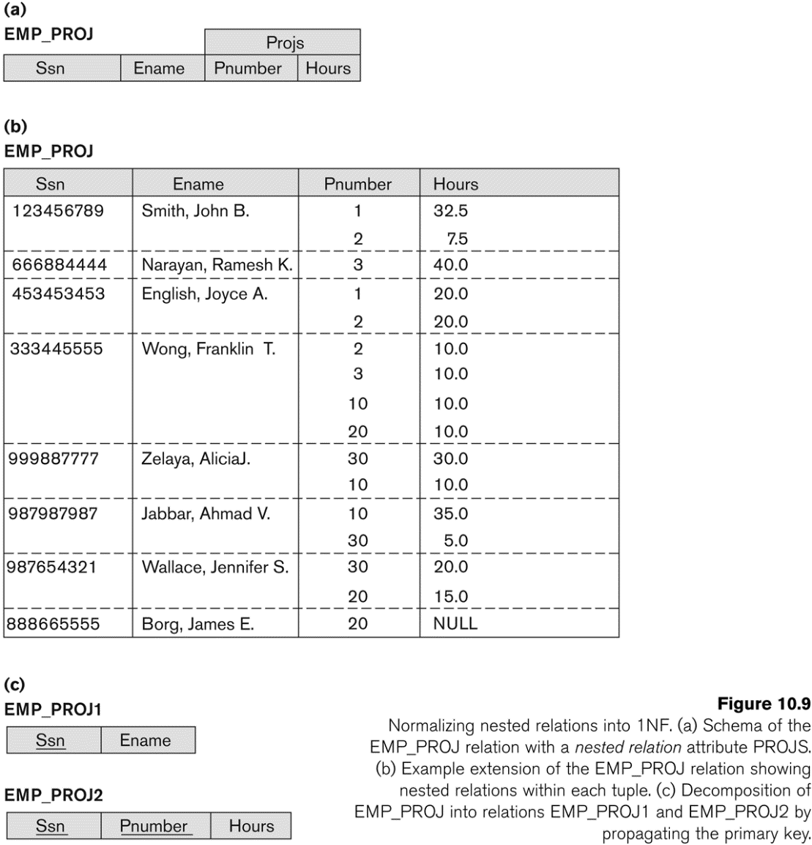
Figure 10.9 Normalization nested relations into 1NF
Slide 10- <number>

Slide 40
3.3 Second Normal Form (1)
Uses the concepts of FDs, primary key
Definitions
  Prime attribute: An attribute that is member of the primary key K
  Full functional dependency: a FD Y -> Z where removal of any attribute from Y means the FD does not hold any more
Examples:
  {SSN, PNUMBER} -> HOURS is a full FD since neither SSN -> HOURS nor PNUMBER -> HOURS hold
  {SSN, PNUMBER} -> ENAME is not a full FD (it is called a partial dependency ) since SSN -> ENAME also holds
Slide 10- <number>

Slide 41
Second Normal Form (2)
A relation schema R is in second normal form (2NF) if every non-prime attribute A in R is fully functionally dependent on the primary key
R can be decomposed into 2NF relations via the process of 2NF normalization
Slide 10- <number>

Slide 42
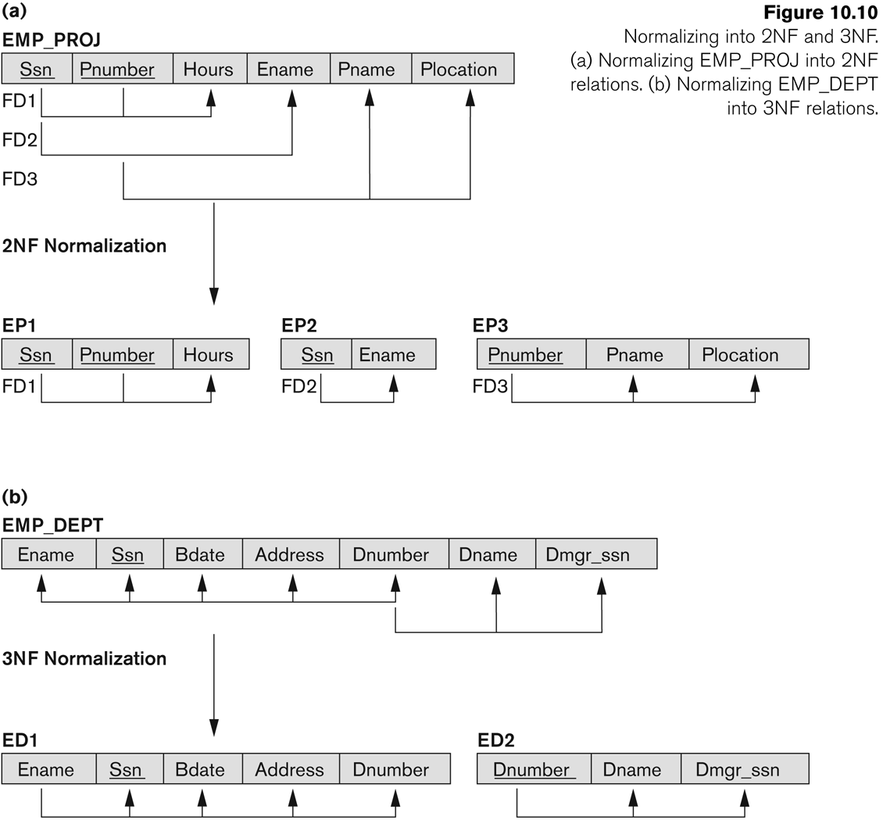
Figure 10.10 Normalizing into 2NF and 3NF
Slide 10- <number>

Slide 43
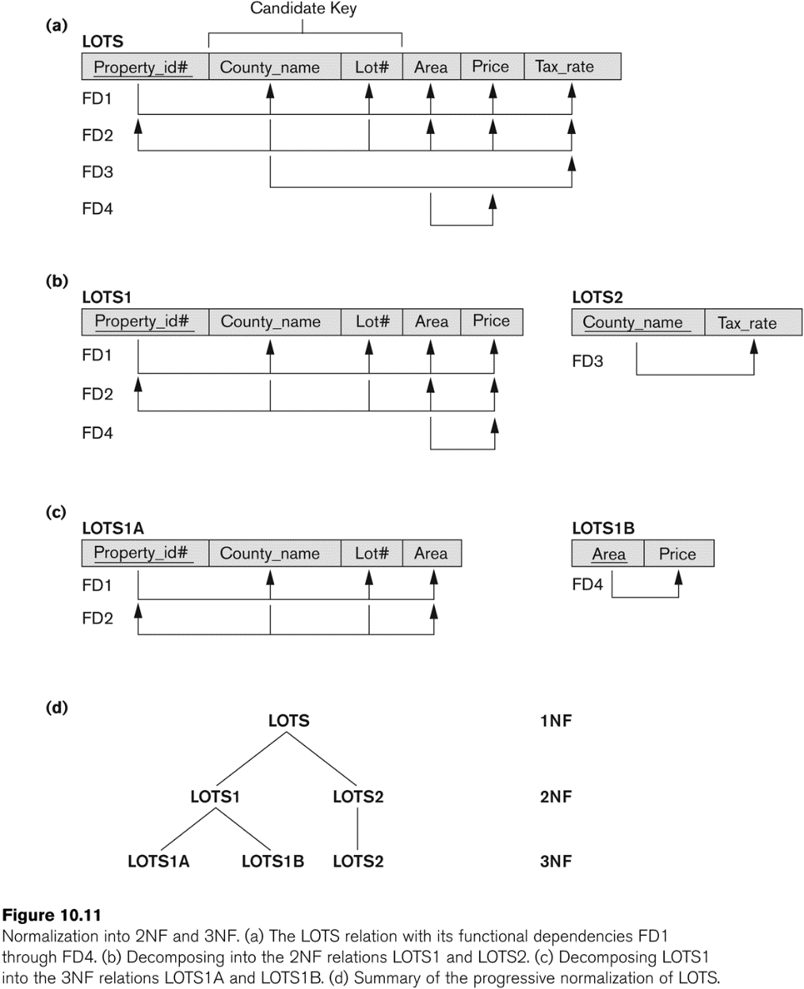
Figure 10.11 Normalization into 2NF and 3NF
Slide 10- <number>

Slide 44
3.4 Third Normal Form (1)
Definition:
  Transitive functional dependency: a FD X -> Z that can be derived from two FDs X -> Y and Y -> Z
Examples:
  SSN -> DMGRSSN is a transitive FD
    Since SSN -> DNUMBER and DNUMBER -> DMGRSSN hold
  SSN -> ENAME is non-transitive
    Since there is no set of attributes X where SSN -> X and X -> ENAME
Slide 10- <number>

Slide 45
Third Normal Form (2)
A relation schema R is in third normal form (3NF) if it is in 2NF and no non-prime attribute A in R is transitively dependent on the primary key
R can be decomposed into 3NF relations via the process of 3NF normalization
NOTE:
  In X -> Y and Y -> Z, with X as the primary key, we consider this a problem only if Y is not a candidate key.
  When Y is a candidate key, there is no problem with the transitive dependency .
  E.g., Consider EMP (SSN, Emp#, Salary ).
    Here, SSN -> Emp# -> Salary and Emp# is a candidate key.
Slide 10- <number>

Slide 46
Normal Forms Defined Informally
1st normal form
  All attributes depend on the key
2nd normal form
  All attributes depend on the whole key
3rd normal form
  All attributes depend on nothing but the key
Slide 10- <number>

Slide 47
4 General Normal Form Definitions (For Multiple Keys) (1)
The above definitions consider the primary key only
The following more general definitions take into account relations with multiple candidate keys
A relation schema R is in second normal form (2NF) if every non-prime attribute A in R is fully functionally dependent on every key of R
Slide 10- <number>

Slide 48
General Normal Form Definitions (2)
Definition:
  Superkey of relation schema R - a set of attributes S of R that contains a key of R
  A relation schema R is in third normal form (3NF) if whenever a FD X -> A holds in R, then either:
    (a) X is a superkey of R, or
    (b) A is a prime attribute of R
NOTE: Boyce-Codd normal form disallows condition (b) above
Slide 10- <number>

Slide 49
5 BCNF (Boyce-Codd Normal Form)
A relation schema R is in Boyce-Codd Normal Form (BCNF) if whenever an FD X -> A holds in R, then X is a superkey of R
Each normal form is strictly stronger than the previous one
  Every 2NF relation is in 1NF
  Every 3NF relation is in 2NF
  Every BCNF relation is in 3NF
There exist relations that are in 3NF but not in BCNF
The goal is to have each relation in BCNF (or 3NF)
Slide 10- <number>

Slide 50
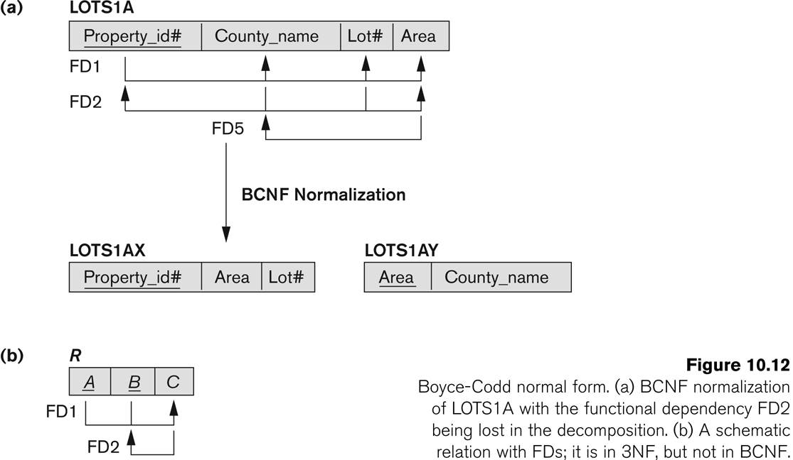
Figure 10.12 Boyce-Codd normal form
Slide 10- <number>

Slide 51
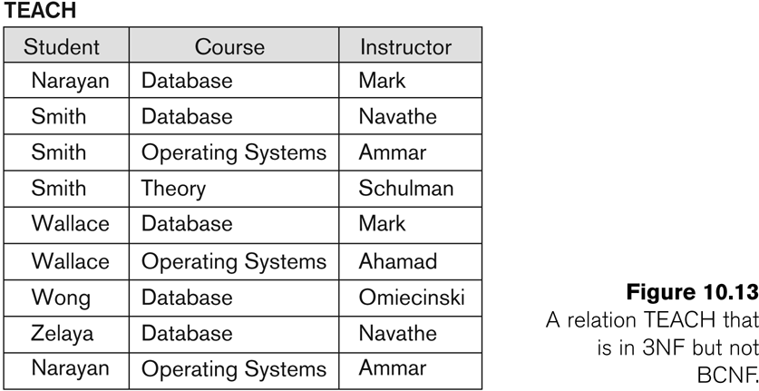
Figure 10.13 a relation TEACH that is in 3NF but not in BCNF
Slide 10- <number>

Slide 52
Achieving the BCNF by Decomposition (1)
Two FDs exist in the relation TEACH:
  fd1: { student, course} -> instructor
  fd2: instructor -> course
{student, course} is a candidate key for this relation and that the dependencies shown follow the pattern in Figure 10.12 (b).
  So this relation is in 3NF but not in BCNF
A relation NOT in BCNF should be decomposed so as to meet this property, while possibly forgoing the preservation of all functional dependencies in the decomposed relations.
  (See Algorithm 11.3)
Slide 10- <number>

Slide 53
Achieving the BCNF by Decomposition (2)
Three possible decompositions for relation TEACH
  {student, instructor} and {student, course}
  {course, instructor } and {course, student}
  {instructor, course } and {instructor, student}
All three decompositions will lose fd1.
  We have to settle for sacrificing the functional dependency preservation. But we cannot sacrifice the non-additivity property after decomposition.
Out of the above three, only the 3rd decomposition will not generate spurious tuples after join.(and hence has the non-additivity property).
A test to determine whether a binary decomposition (decomposition into two relations) is non-additive (lossless) is discussed in section 11.1.4 under Property LJ1. Verify that the third decomposition above meets the property.
Slide 10- <number>

Slide 54
Chapter Outline
Informal Design Guidelines for Relational Databases
Functional Dependencies (FDs)
  Definition, Inference Rules, Equivalence of Sets of FDs, Minimal Sets of FDs
Normal Forms Based on Primary Keys
General Normal Form Definitions (For Multiple Keys)
BCNF (Boyce-Codd Normal Form)
Slide 10- <number>

